Slide 1
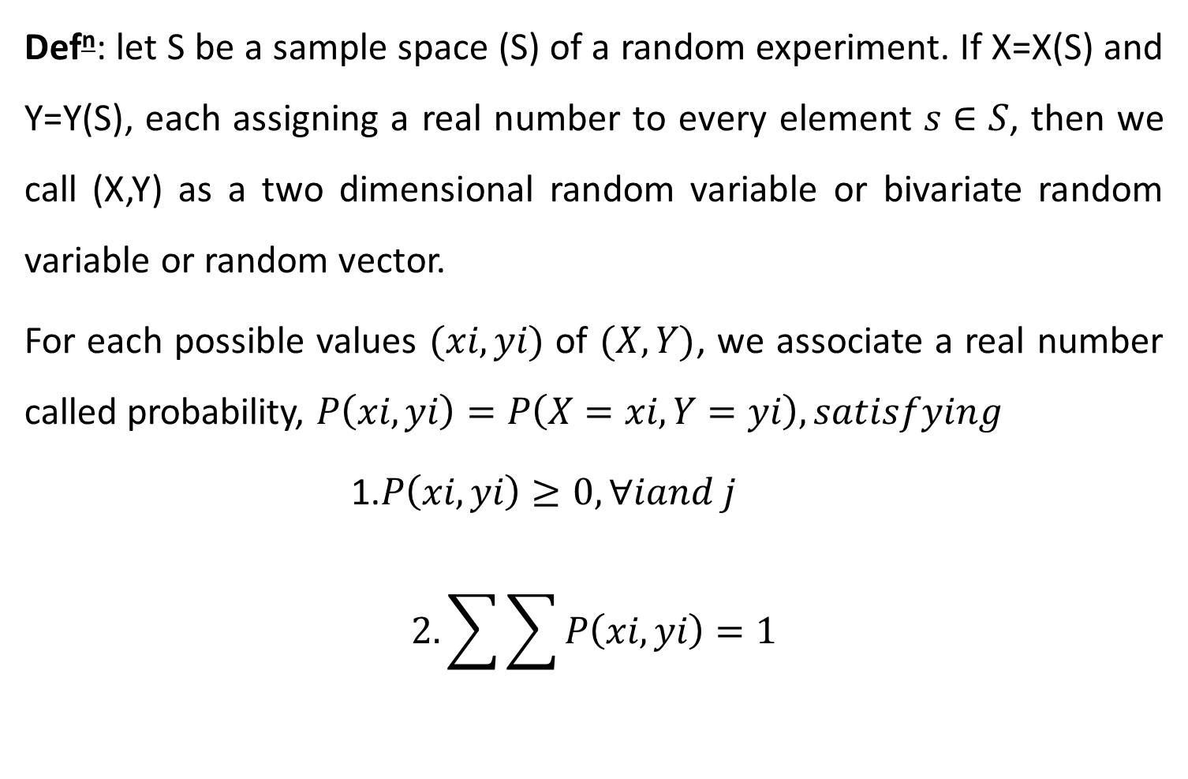
Two dimensional Random Variables
Def^{n}: let S be a sample space (S) of a random experiment. If X=X(S) and Y=Y(S), each assigning a real number to every element $s∈S$, then we call (X,Y) as a two dimensional random variable or bivariate random variable or random vector.
For each possible values $(xi,yi)$ of $(X,Y)$, we associate a real number called probability, $P\left(xi,yi\right)=P\left(X=xi,Y=yi\right), satisfying$
1.$P\left(xi,yi\right)≥0,∀iand j$
$$2.\sum{\sum{P\left(xi,yi\right)}}=1$$

Slide 2

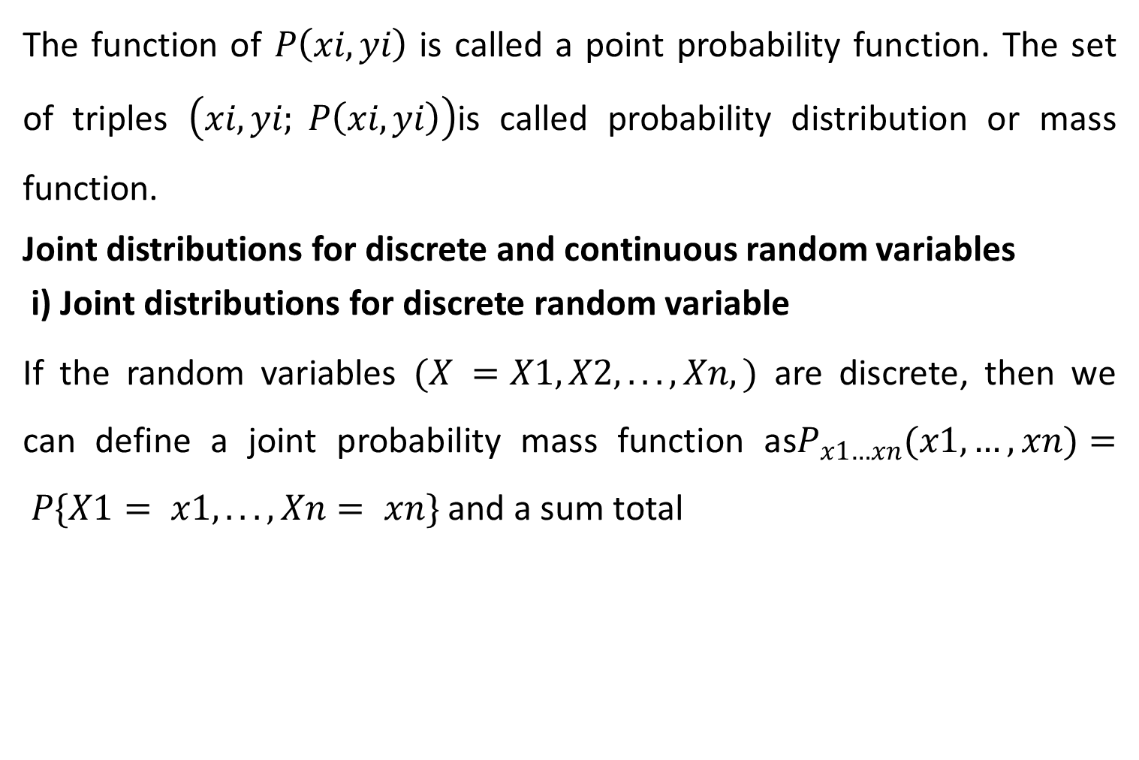
Con’t….
The function of $P\left(xi,yi\right)$ is called a point probability function. The set of triples $\left(xi,yi; P\left(xi,yi\right)\right)$is called probability distribution or mass function.
Joint distributions for discrete and continuous random variables
i) Joint distributions for discrete random variable
If the random variables $(X =X1, X2, . . . , Xn,)$ are discrete, then we can define a joint probability mass function as$P_{x1…xn}(x1,…,xn)= P\{X1= x1, . . . , Xn= xn\}$ and a sum total

Slide 3
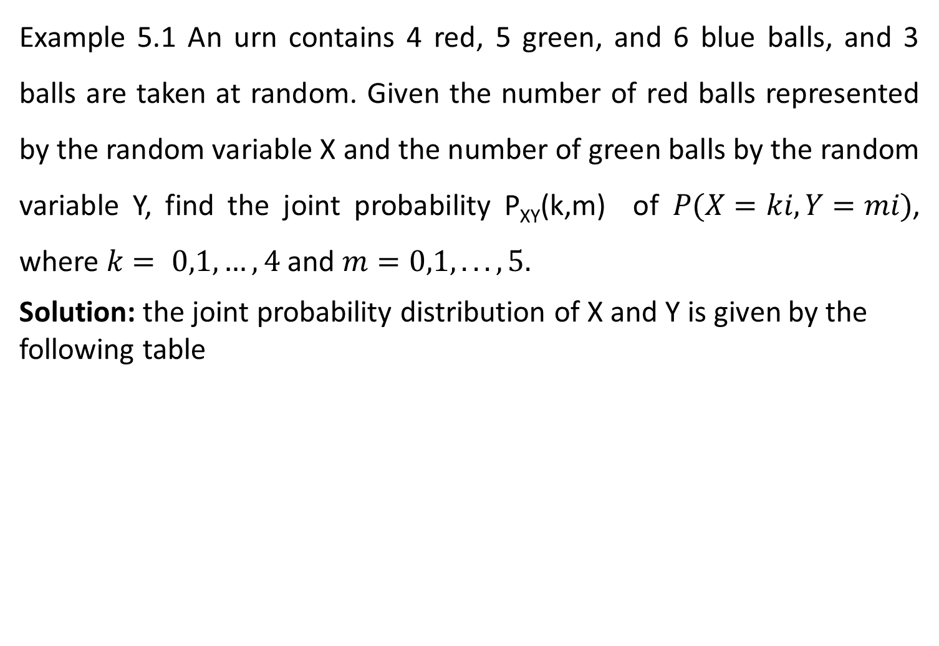
Con’t….
Example 5.1 An urn contains 4 red, 5 green, and 6 blue balls, and 3 balls are taken at random. Given the number of red balls represented by the random variable X and the number of green balls by the random variable Y, find the joint probability P_{XY}(k,m) of $P(X=ki,Y=mi)$, where $k= 0,1,…,4$ and $m=0,1,...,5.$
Solution: the joint probability distribution of X and Y is given by the following table

Slide 4

Con’t…
X |  | 0 | 1 | 2 | 3 | 4
Y | 0 | 6C3/15C3 | 6C2*4C1/15C3 | 4C2*6C1/15C3 | 4C3/15C3 | 0
 | 1 | 5C1*6C2/15C3 | 5C1*4C1*6C1/15C3 | 5C1*4C2/15C3 | 0 | 0
 | 2 | 5C2*6C1/15C3 | 5C2*4C1/15C3 | 0 | 0 | 0
 | 3 | 5C3/15C3 | 0 | 0 | 0 | 0
 | 4 | 0 | 0 | 0 | 0 | 0
 | 5 | 0 | 0 | 0 | 0 | 0
where $6C3=\left(\begin{aligned}6 \\ 3\end{aligned}\right)$
Shortly it can be written as:

Slide 5
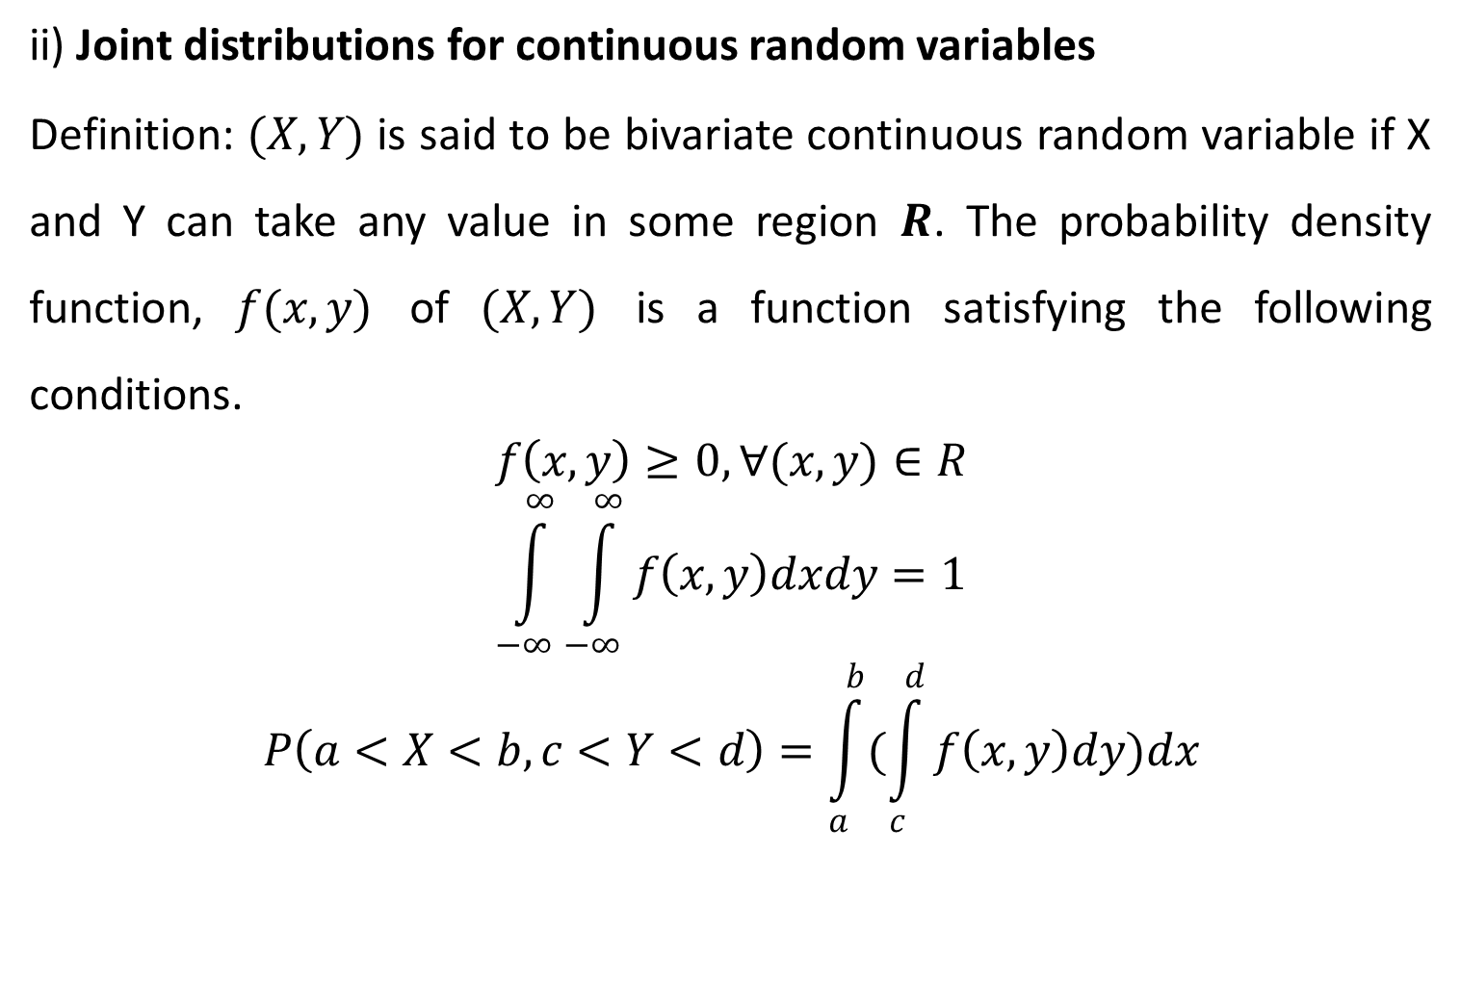
Con’t….
ii) Joint distributions for continuous random variables
Definition: $(X,Y)$ is said to be bivariate continuous random variable if X and Y can take any value in some region $R$. The probability density function, $f(x,y)$ of $(X,Y)$ is a function satisfying the following conditions.
$$f\left(x,y\right)≥0,∀(x,y)∈R$$
$$\int_{−∞}^{∞}{\int_{−∞}^{∞}{f\left(x,y\right)dxdy=1}}$$
$$P\left(a<X<b,c<Y<d\right)=\int_{a}^{b}{(\int_{c}^{d}{f\left(x,y\right)dy)dx}}$$

Slide 6
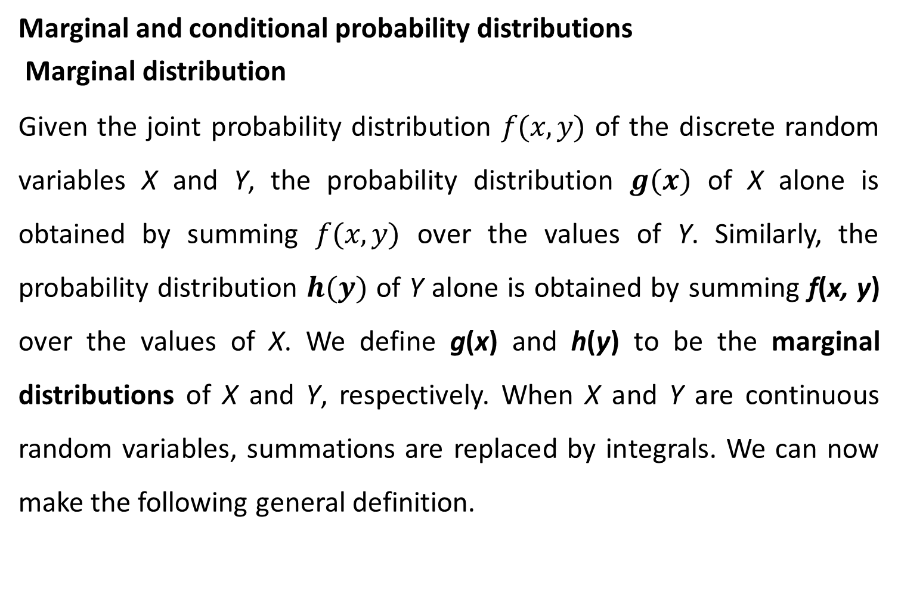
Con’t…
Marginal and conditional probability distributions
Marginal distribution
Given the joint probability distribution $f(x, y)$ of the discrete random variables X and Y, the probability distribution $g(x)$ of X alone is obtained by summing $f(x, y)$ over the values of Y. Similarly, the probability distribution $h(y)$ of Y alone is obtained by summing f(x, y) over the values of X. We define g(x) and h(y) to be the marginal distributions of X and Y, respectively. When X and Y are continuous random variables, summations are replaced by integrals. We can now make the following general definition.

Slide 7
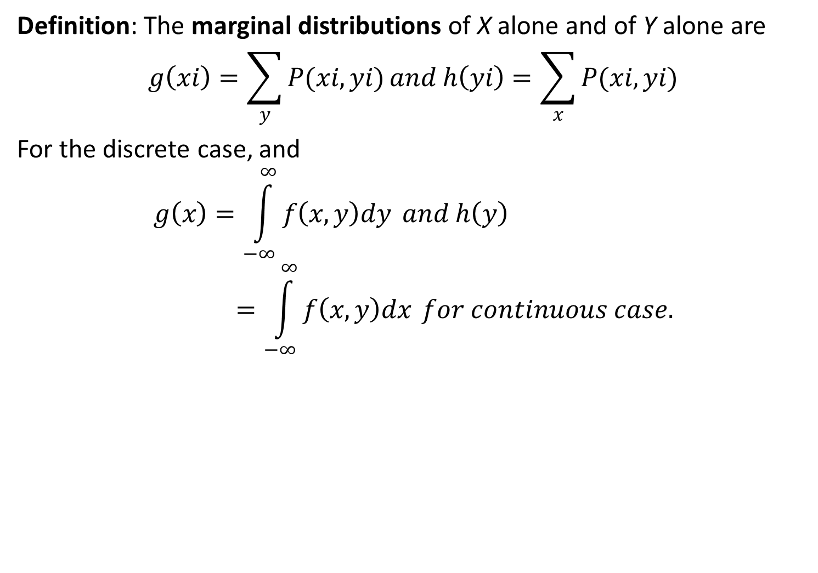
Con’t…
Definition: The marginal distributions of X alone and of Y alone are
$$g\left(xi\right)=\sum_{y}{P(xi,yi)}and h\left(yi\right)=\sum_{x}{P(xi,yi)}$$
For the discrete case, and
$$g\left(x\right)=\int_{−∞}^{∞}{f\left(x,y\right)dy} and h\left(y\right)=\int_{−∞}^{∞}{f\left(x,y\right)dx }for continuous case.$$

Slide 8
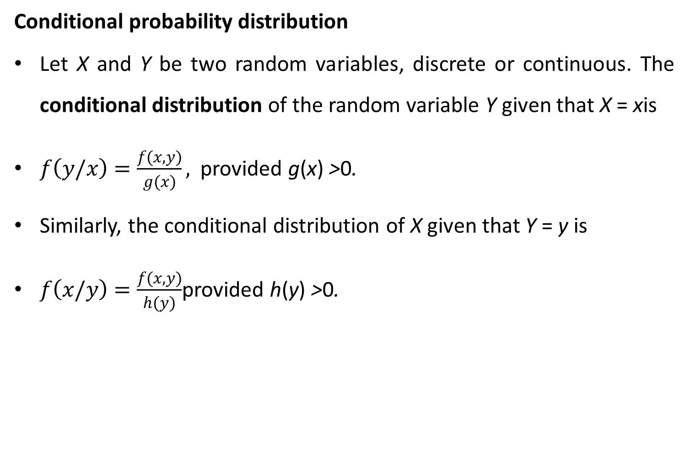
Con’t….
Conditional probability distribution
Let X and Y be two random variables, discrete or continuous. The conditional distribution of the random variable Y given that X = xis
$f\left(y/x\right)=\frac{f(x,y)}{g(x)},$provided g(x) >0.
Similarly, the conditional distribution of X given that Y = y is
$f\left(x/y\right)=\frac{f(x,y)}{h(y)}$provided h(y) >0.

Slide 9
Con’t…
Expectation of XY : the definition of E(XY )
Suppose we have two random variables, X and Y . These might be independent, in which case the value of X has no effect on the value of Y . Alternatively, X and Y might be dependent: when we observe a random value for X, it might influence the random values of Y that we are most likely to observe. For example, X might be the height of a randomly selected person, and Y might be the weight. On the whole, larger values of X will be associated with larger values of Y .

Slide 10
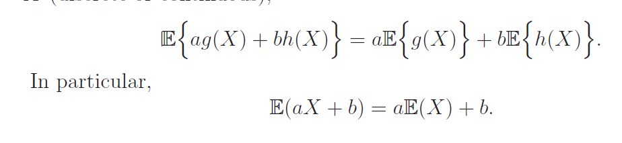
Con’t…
Properties of Expectation
Let g and h be functions, and let a and b be constants. For any random variable X (discrete or continuous),

Slide 11
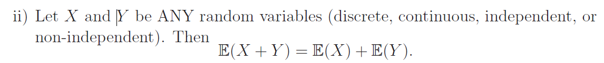
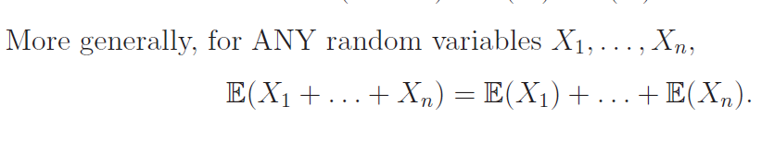
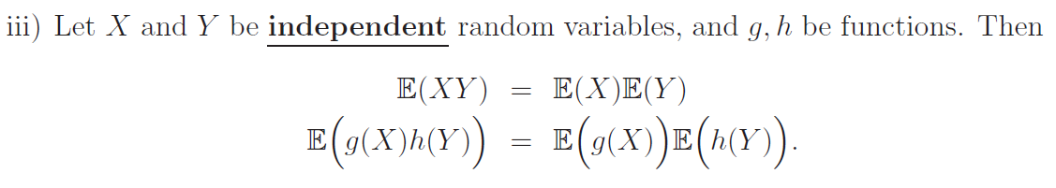
Con’t…

Slide 12
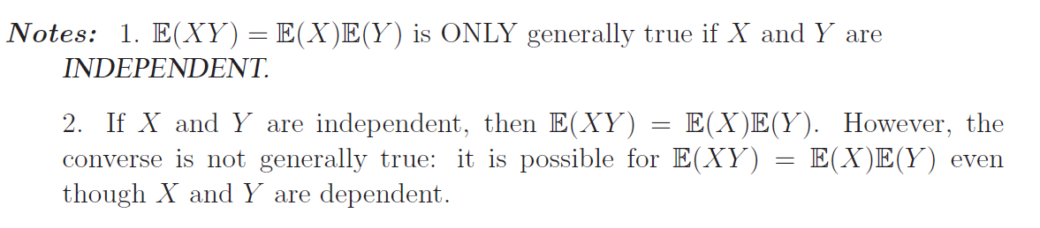
Con’t…

Slide 13
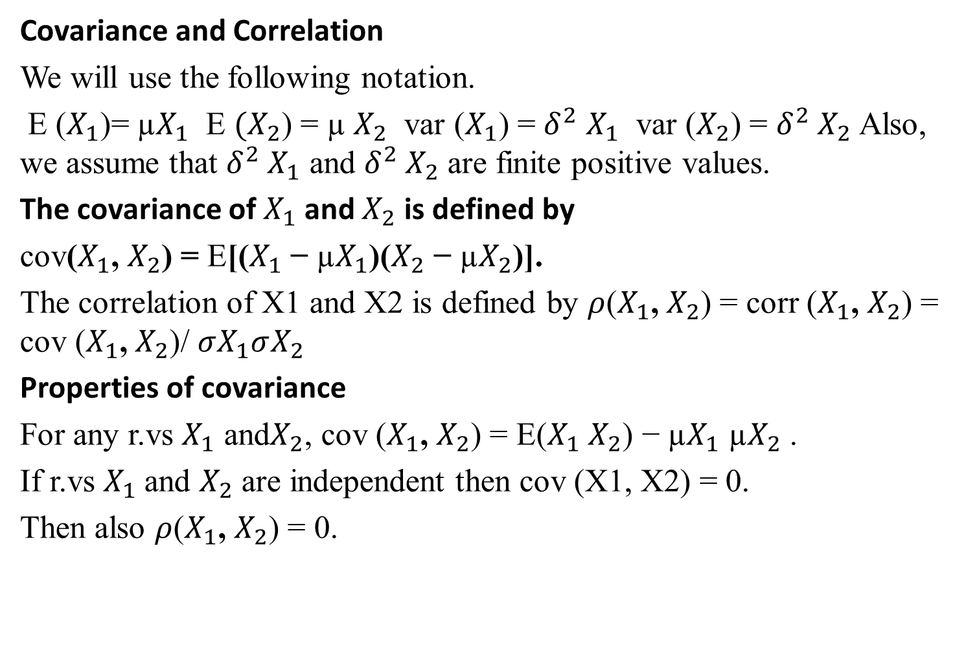
Con’t…
Covariance and Correlation
We will use the following notation.
E ($X_{1}$)= µ$X_{1}$ E ${(X}_{2}$) = µ $X_{2}$ var ($X_{1}$) = $δ^{2}$ $X_{1}$ var ($X_{2}$) = $δ^{2} X_{2}$Also, we assume that $δ^{2} X_{1}$ and $δ^{2} X_{2}$ are finite positive values.
The covariance of $X_{1}$ and $X_{2}$ is defined by
cov($X_{1}$, $X_{2}$) = E[($X_{1}$ − µ$X_{1}$)($X_{2}$ − µ$X_{2}$)].
The correlation of X1 and X2 is defined by $ρ$($X_{1}$, $X_{2}$) = corr ($X_{1}$, $X_{2}$) = cov ($X_{1}$, $X_{2}$)/ $σX_{1}σX_{2}$
Properties of covariance
For any r.vs $X_{1}$ and$X_{2}$, cov ($X_{1}$, $X_{2}$) = E($X_{1}$ $X_{2}$) − µ$X_{1}$ µ$X_{2}$ .
If r.vs $X_{1}$and $X_{2}$ are independent then cov (X1, X2) = 0.
Then also $ρ$($X_{1}$, $X_{2}$) = 0.

Slide 14
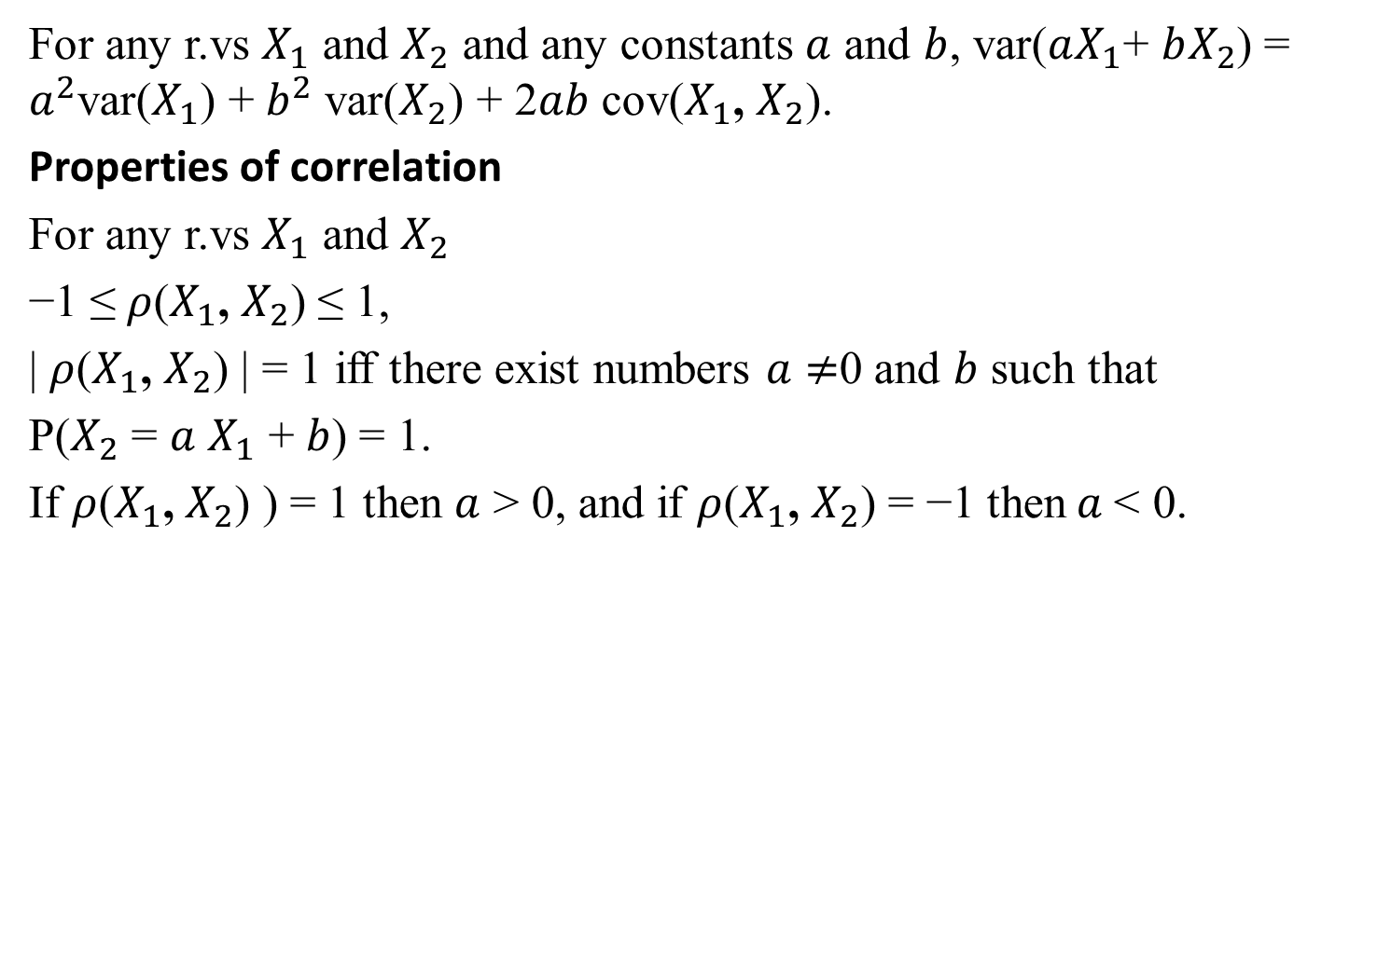
Con’t…
For any r.vs $X_{1}$ and $X_{2}$ and any constants $a$ and $b$, var($aX_{1}$+ $bX_{2}$) = $a^{2}$var($X_{1}$) + $b^{2}$var($X_{2}$) + 2$ab$ cov($X_{1}$, $X_{2}$).
Properties of correlation
For any r.vs $X_{1}$ and $X_{2}$
−1 ≤ $ρ$($X_{1}$, $X_{2}$) ≤ 1,
| $ρ$($X_{1}$, $X_{2}$) | = 1 iff there exist numbers $a$ $≠$0 and $b$ such that
P($X_{2}$ = $a$ $X_{1}$ + $b$) = 1.
If $ρ$($X_{1}$, $X_{2}$) ) = 1 then $a$ > 0, and if $ρ$($X_{1}$, $X_{2}$) = −1 then$a$< 0.

